Slide 1
StudyTrack – AI-Based Student Study Habit Recommender
A Project developed under
INFOSYS SPRINGBOARD
Under the guidance of Anil Kumar - Infosys Springboard Mentor
Domain: Python and Al / Machine Learning

Slide 2
What is Study Track Al?
StudyTrack Al is an innovative, Al-based student performance analysis system designed to revolutionize academic guidance. It leverages advanced predictive analytics to offer unprecedented insights into student learning patterns. Our system goes beyond traditional metrics, analyzing various behavioral data points to accurately predict academic outcomes and provide tailored recommendations, fostering a proactive approach to student success.

Slide 3
PROJECT OVERVIEW
Problem statement
• Students follow different study patterns without structured analysis
• Academic feedback is often delayed and generic
• No predictive system to identify at-risk students early
• Lack of personalized improvement strategies
Solution - 🎓StudyTrack
Collects student habit data
Uses ML models to analyze patterns
Predicts performance & clusters students
Provides actionable insights

Slide 4


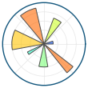

Technologies Used
This project leverages open-source, industry-standard technologies to ensure stability, scalability, and ease of deployment within an academic context.
Python
AI / Ml
For predictions modelling and data clustering part
Matplotlib
For predictions modelling and data
clustering part
Streamlit
For predictions modelling and data
clustering partused to rapid development and deployment of the interactivity web user interface
Core programming language for application logic and data processing

Slide 5
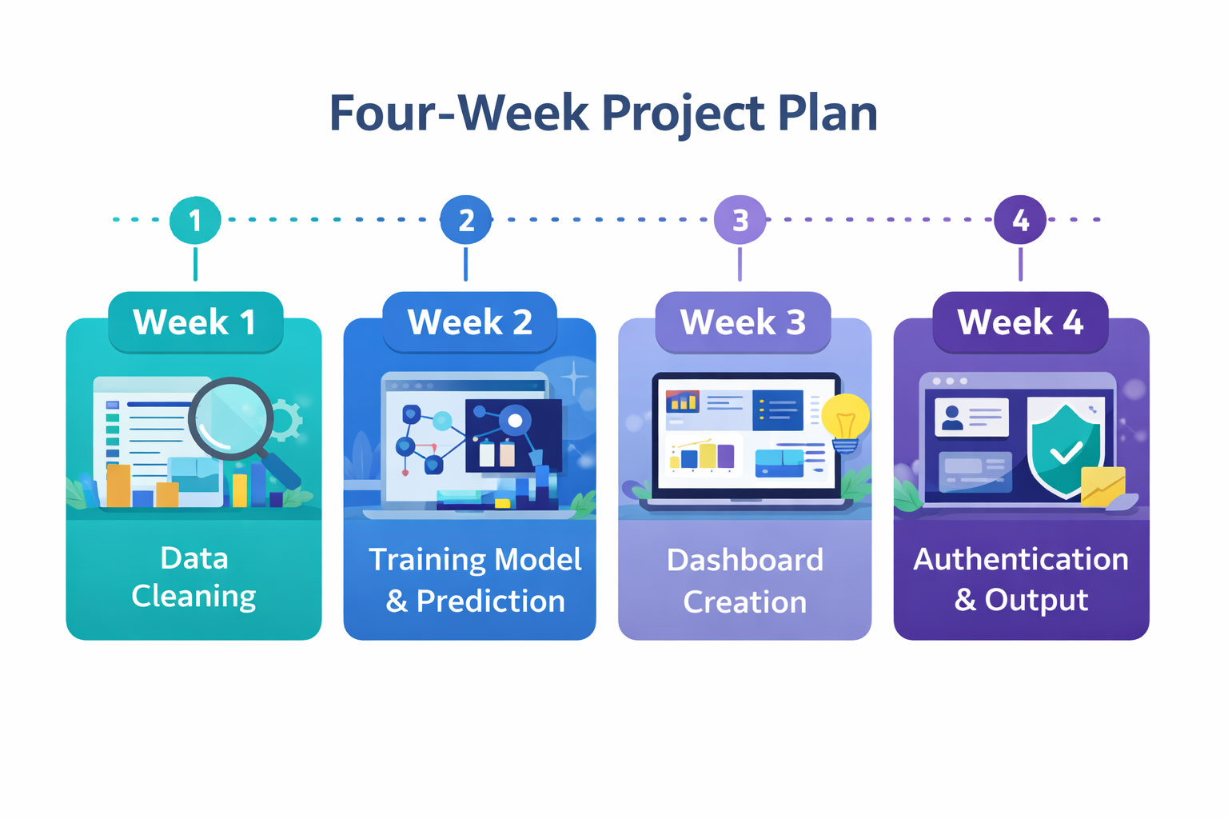
Milestone 1 Data Foundation: Cleaning & Exploratory Analysis
Milestone 2 Behavioral Segmentation: Clustering & Performance Analysis
Project Roadmap
Milestone 3 Actionable Insights: Analytics Dashboard & Recommendations
Milestone 4
Authentication & Final Output : Login/Signup Page and
Submission

Slide 6
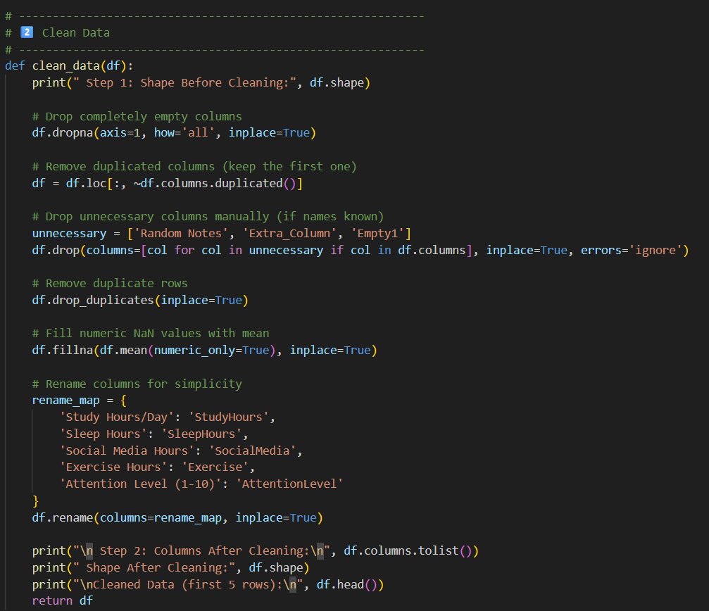
Milestone 1 : Data Cleaning
Objectives
Complete empty columns are removed
Clean and preprocess dataset
Handle missing & duplicate values

Slide 7
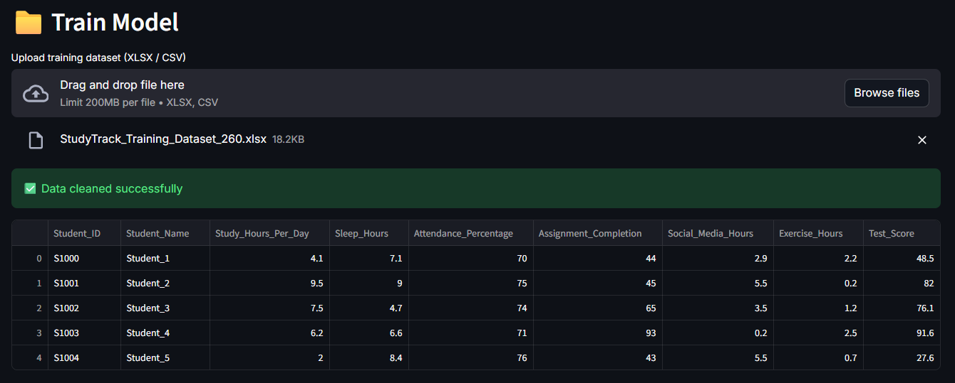

Milestone 2 : Training Models and Prediction
Objective
Goals
Trained regression model to predict test scores
Evaluated model using R² score and MSE
Implemented individual and bulk prediction workflows

Slide 8
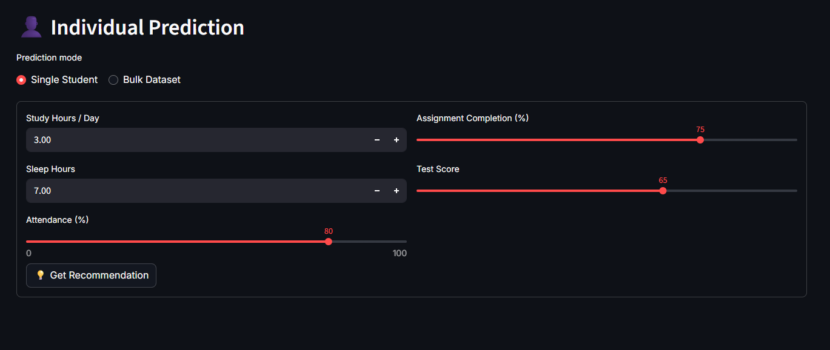
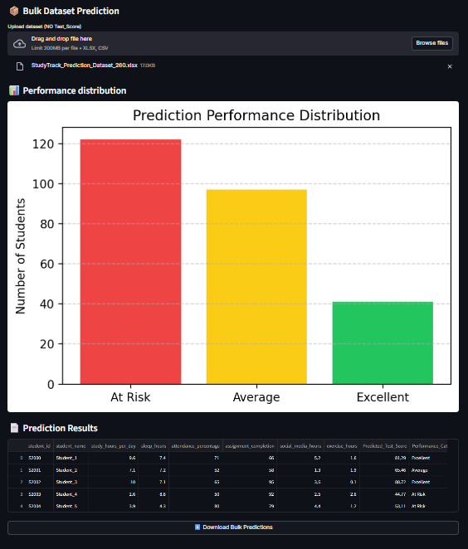
Individual Prediction
I
👤
Bulk Database Prediction
📦

Slide 9
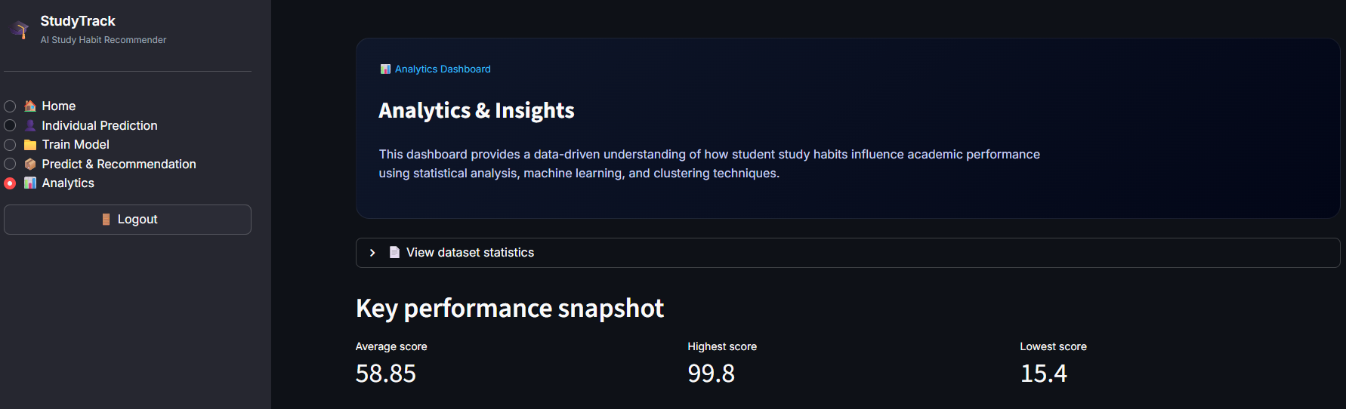
Milestone 3 : Dashboard Design
The Pre-final week involved developing an interactive analytics dashboard to visualize student habits and performance trends. The dashboard offered personalized study recommendations to optimize academic outcomes. This tool enhanced user engagement and presented complex data in an accessible, actionable format.

Slide 10
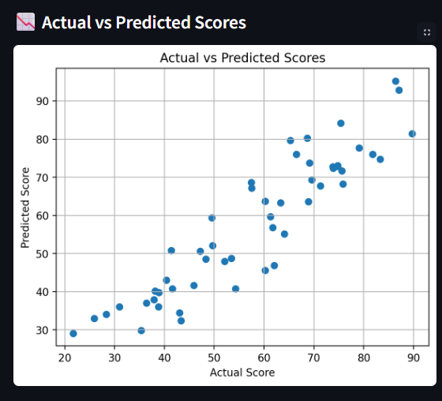
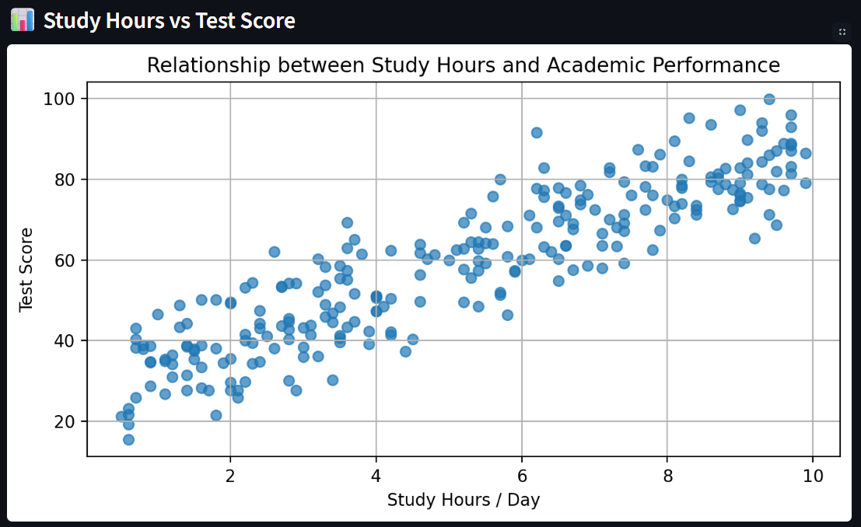
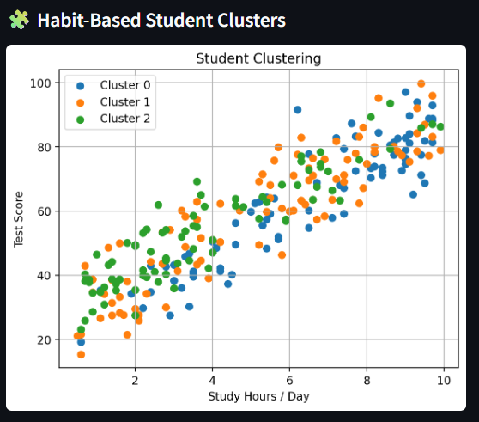

Slide 11
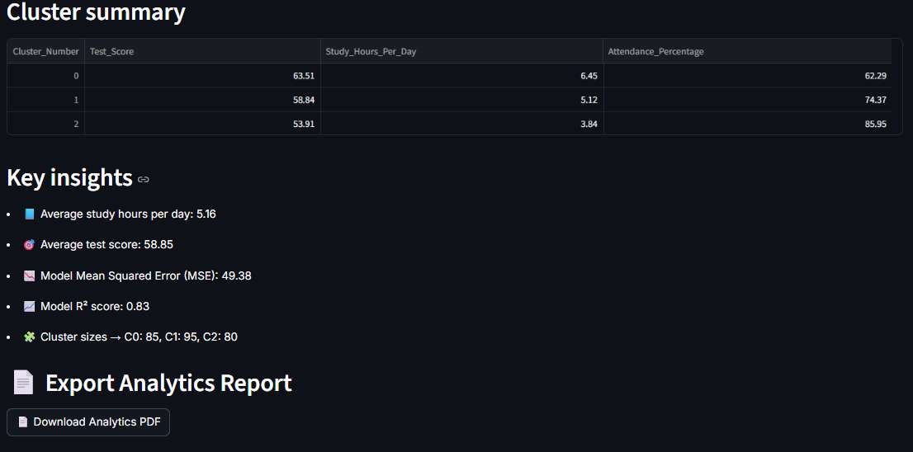

Slide 12
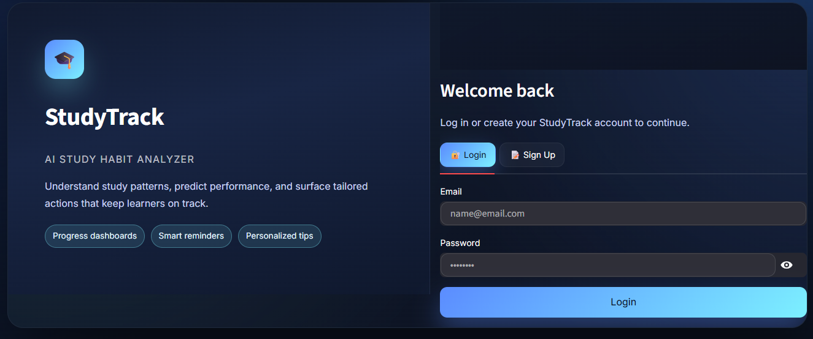
Milestone 4 : User Authentication and Final Output
The Pre-final week involved developing an interactive analytics dashboard to visualize student habits and performance trends. The dashboard offered personalized study recommendations to optimize academic outcomes. This tool enhanced user engagement and presented complex data in an accessible, actionable format.

Slide 13
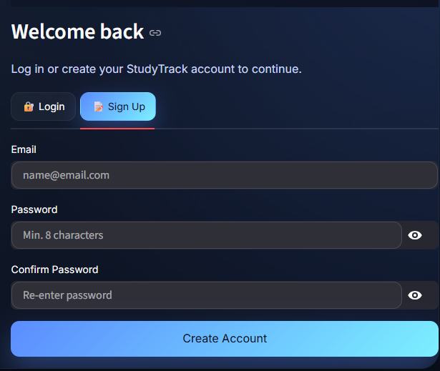
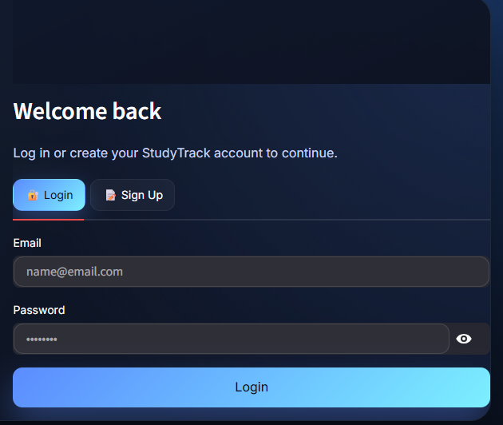

Slide 14
Conclusions
The StudyTrack project successfully integrated AI-driven data processing, clustering, and visualization to analyze student habits. It delivered valuable insights and a practical dashboard for personalized recommendations. This internship exemplified effective collaboration, technical skill application, and potential for academic performance improvement through data science.

Slide 15
Thank you
StudyTrack – AI Study Habit Analyzer
Developed by: Prem Kalse
Guided by: Mr. Anil Kumar

